Slide 1

Beam Search-Based Attention for Image Captioning
Presented by:
Adharsha Thummala
Sabari Samudrala
Swetha Kanduri
Kishore Gundla

Slide 2
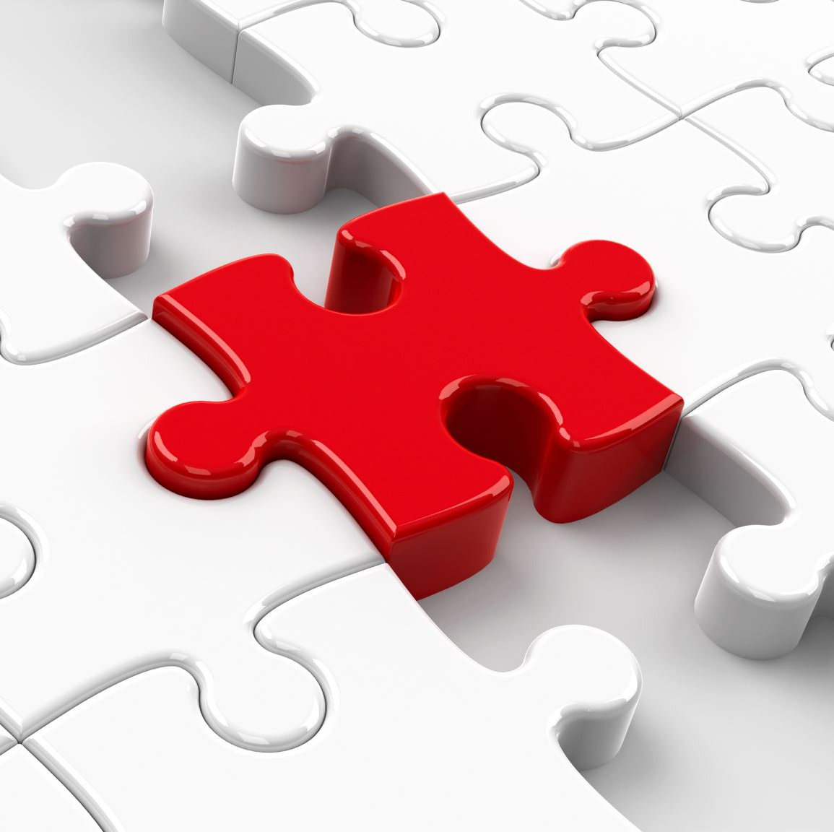
INTRODUCTION:
Image captioning is a task in computer vision and natural language processing, which is used to generate descriptive and accurate captions for images automatically.
In this project, we’ve chosen web application as our platform.
Users will provide an image which is similar to the trained model datasets and the model generates the caption.

Slide 3

PROJECT INSPIRATION
The issue of security and surveillance, where occurs many thefts and other crimes daily are often gets captured in the cameras, but failure to provide captions.
This makes it tough to investigate.
Another reason is it will be helpful for individuals with visual impairments

Slide 4
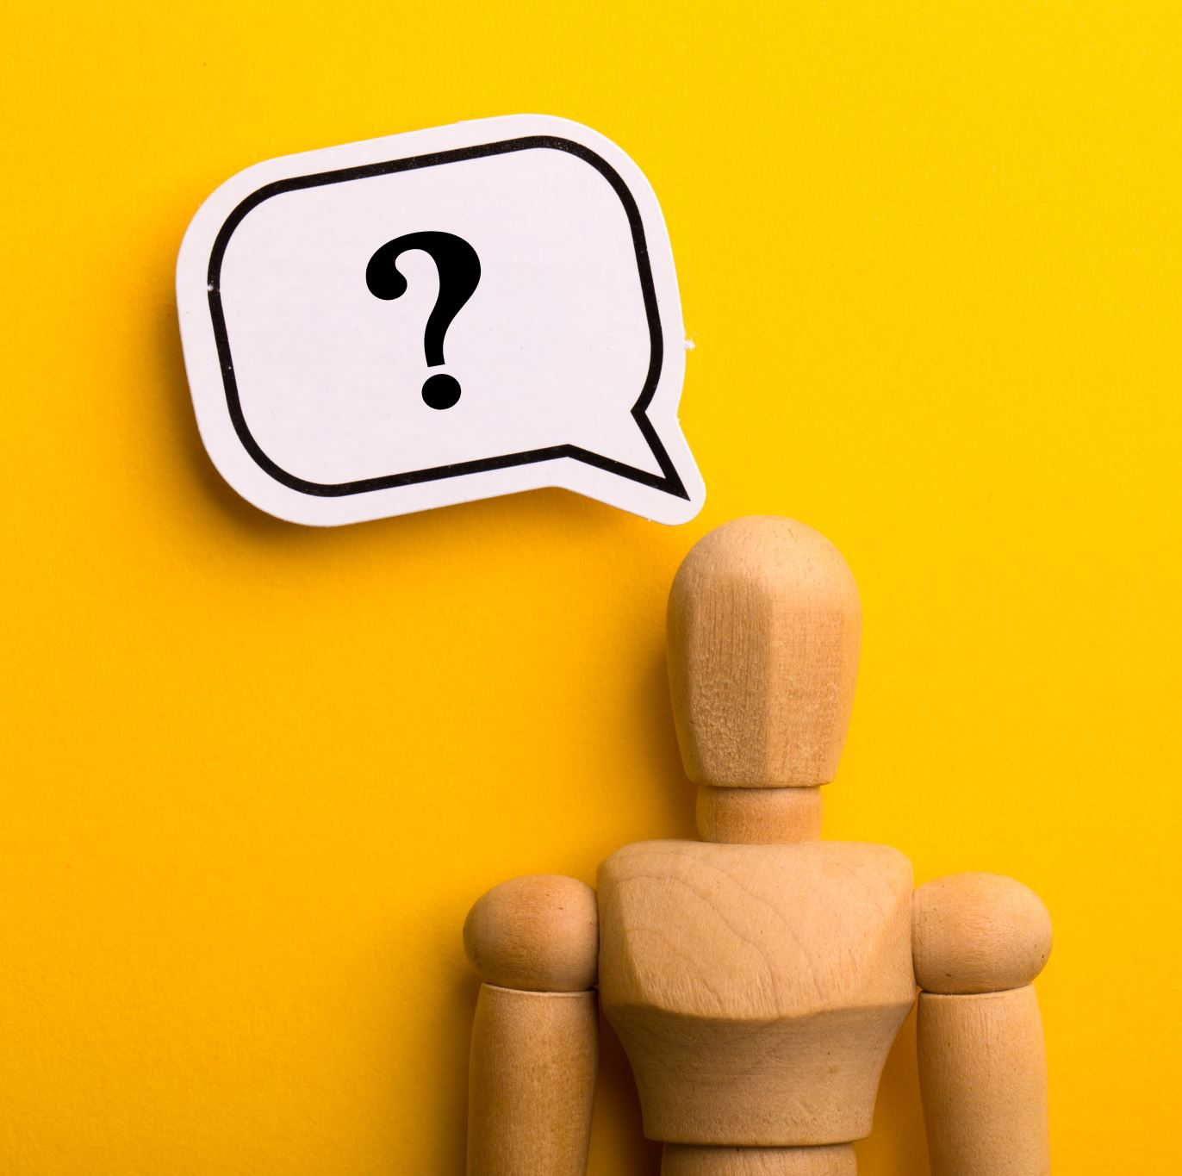
What is Image Captioning?
Image captioning is the task of generating a descriptive sentence or phrase that accurately describes the content of an input image.
We use CNNs to extract features from the images which is then followed by generating captions using RNNs.
The model is trained on image-caption pairs. By adjusting the parameters we can minimize the difference between predicted and actual captions.

Slide 5

SEARCH ALGORITHMS
There are many search algorithms like Greedy search, beam search, random sampling, top k sampling etc.
Most commonly used search algorithms in sequence generation tasks are Greedy search and Beam search. In this project we used beam search.
Beam search is a search algorithm that explores multiple potential sequences simultaneously to find the most likely output sequence.
Beam search is a better option than greedy search because it reduces the risk of getting stuck in local optima, optimizes globally, and is more robust to errors in model predictions.

Slide 6
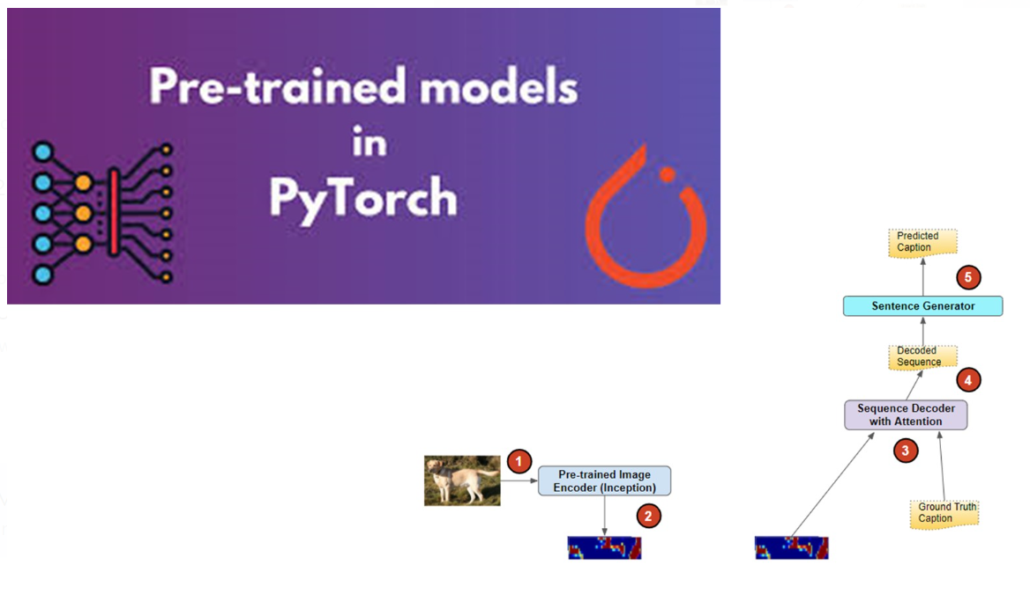

Slide 7
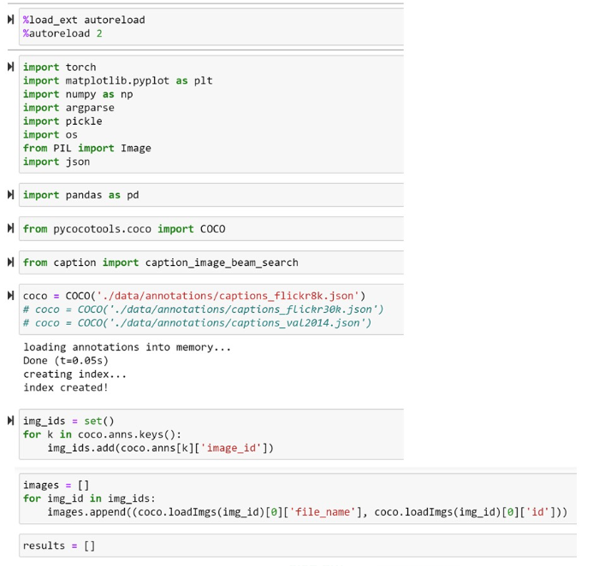

Slide 8
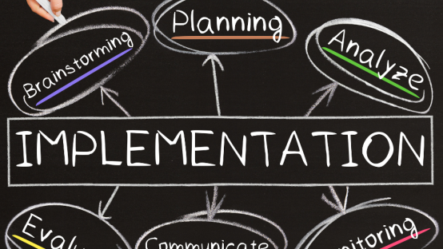

Slide 9
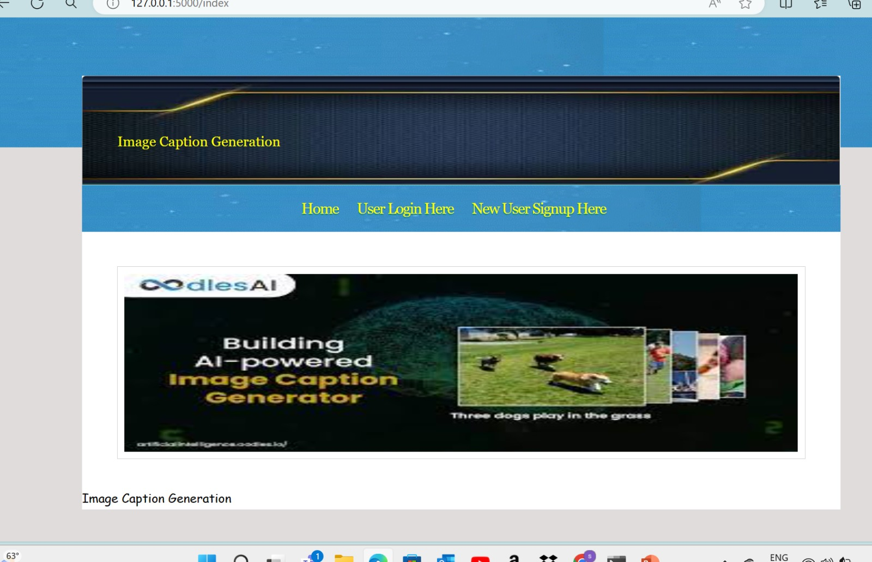

Slide 10
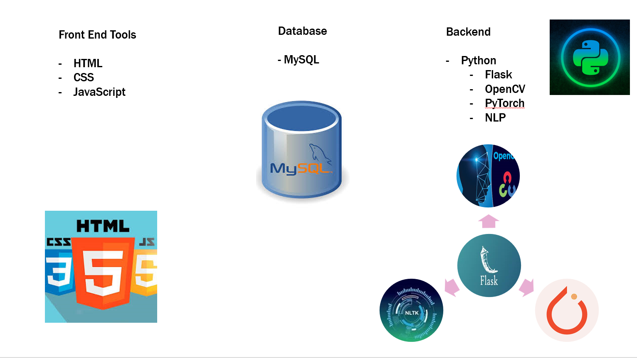

Slide 11
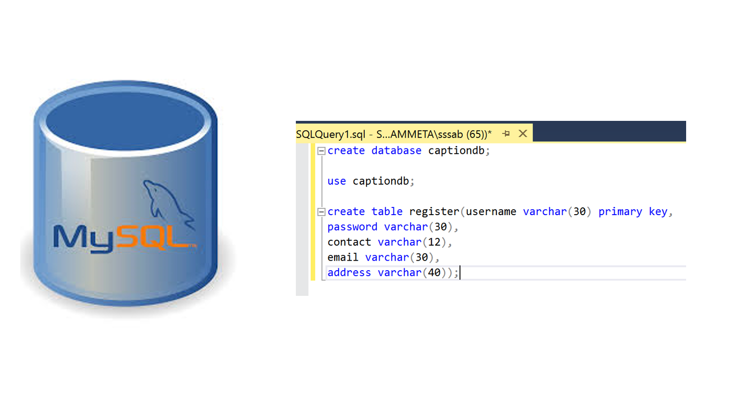

Slide 12
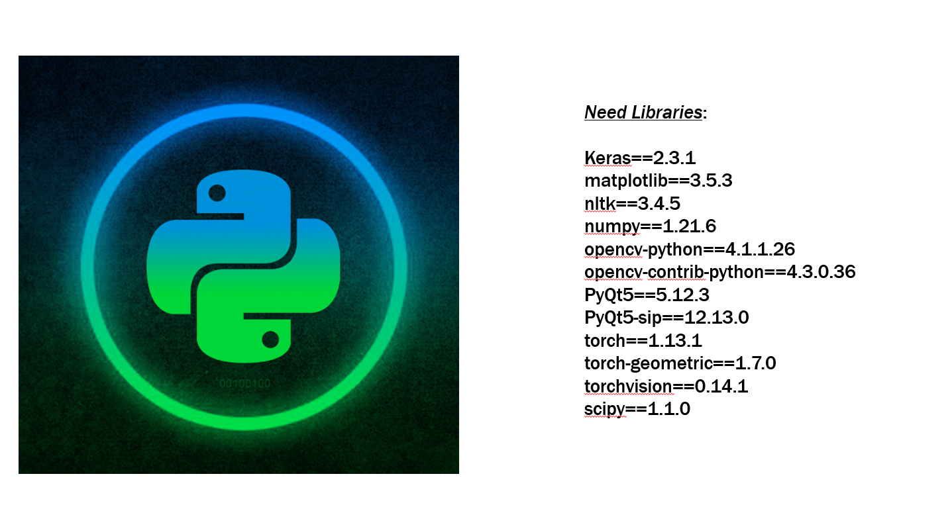

Slide 13
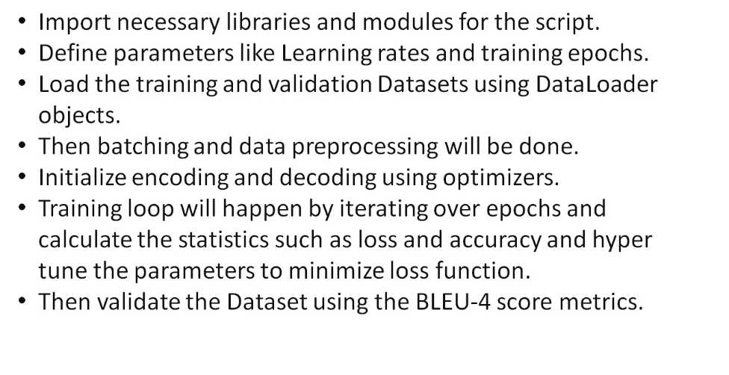

Slide 14
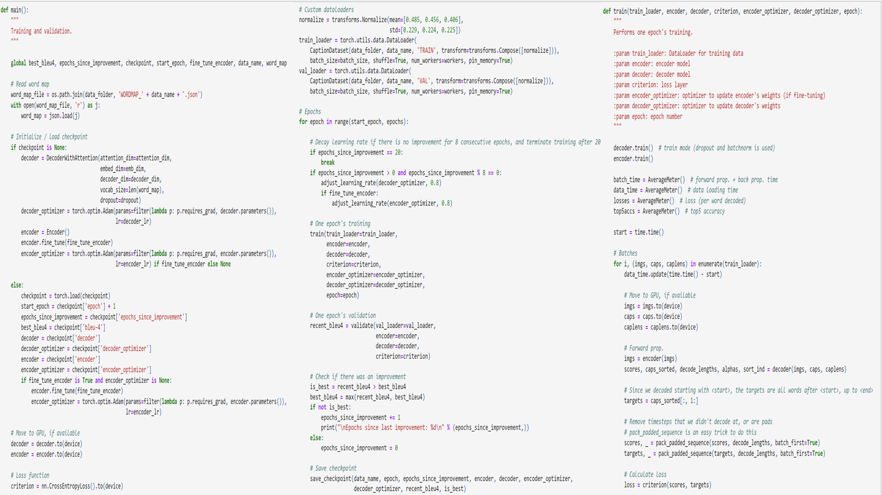

Slide 15

Flask
Using Flask framework in this project likely serves the purpose of creating a web application to deploy and interact with the trained model for generating captions
Flask provides tools and libraries for routing requests, handling form submissions, rendering templates, and more.
Flask uses decorators to map URL patterns to Python functions, making it easy to define routes for different parts of the application.

Slide 16
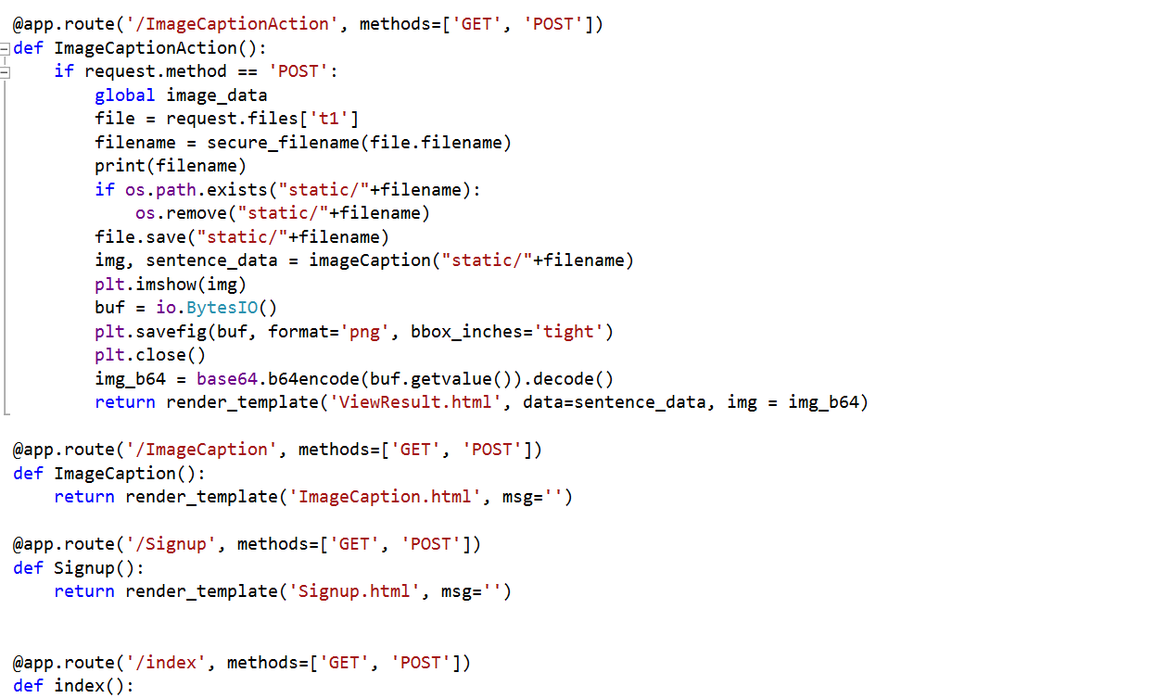
Flask Framework

Slide 17
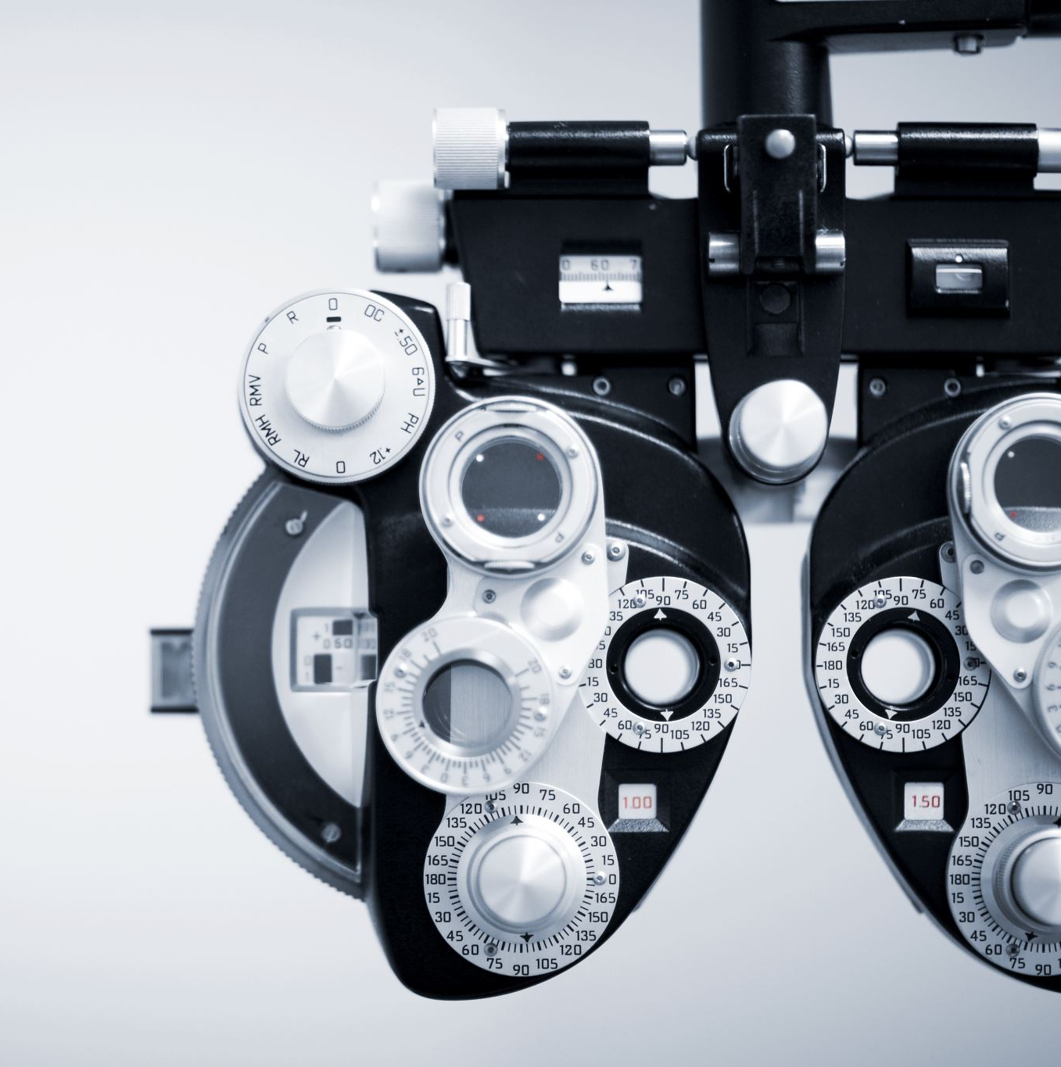
CV2
It provides various functions and tools for image processing, computer vision tasks, and machine learning algorithms related to vision
Image Reading : The cv2.imread() function is used to read the uploaded image from the file system.
Image Preprocessing: The cv2.resize() function is used to resize the image to a specific size (900x500 pixels) so that it can be displayed alongside its caption.
Image Visualization: After generating captions for images, OpenCV can be used to overlay the generated captions onto the images. This can be helpful for visualizing the results and understanding how well the model is performing.

Slide 18
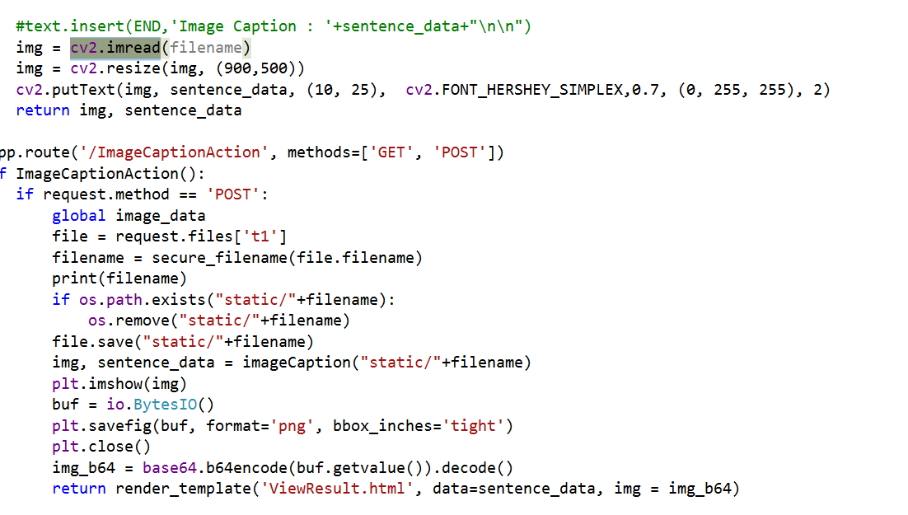

Slide 19
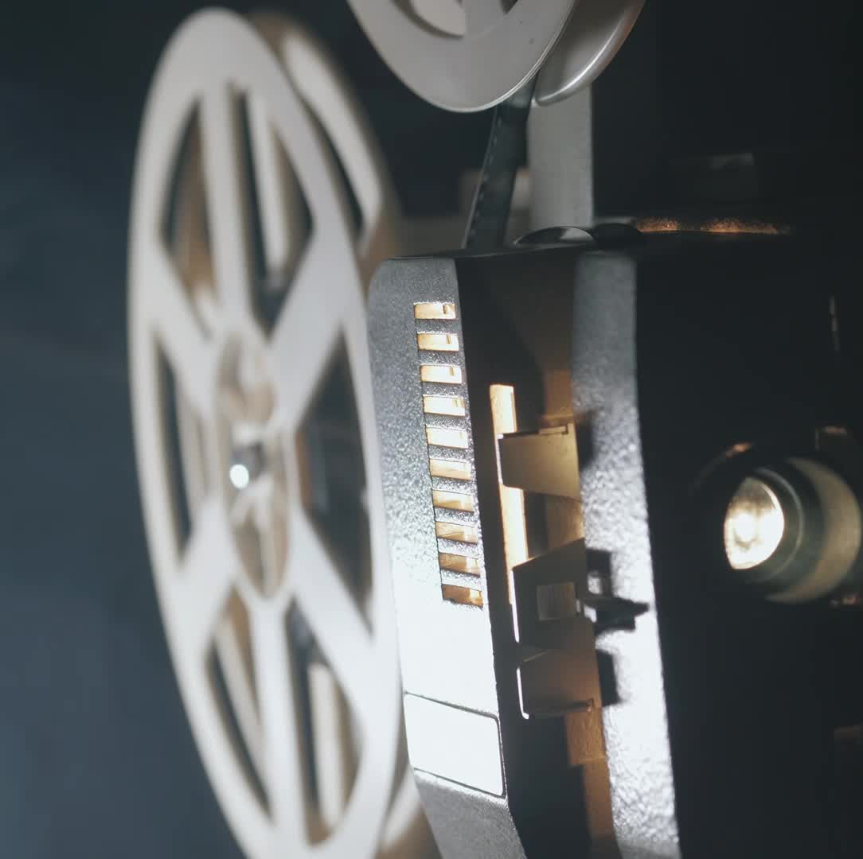
PyTorch
Model Loading: Torch is used to load the pre-trained encoder and decoder models (lstm_encoder and lstm_decoder).
Image Processing: Torch's transforms module is used to preprocess the input image before it is fed into the model for caption generation.
Model Inference: Once an image is preprocessed, Torch is used to feed the image through the encoder to obtain image features . These features are then used as input to the decoder model to generate a caption for the image .
Device Handling: Torch's device handling functionality is used to check if a GPU is available for accelerating computations.

Slide 20
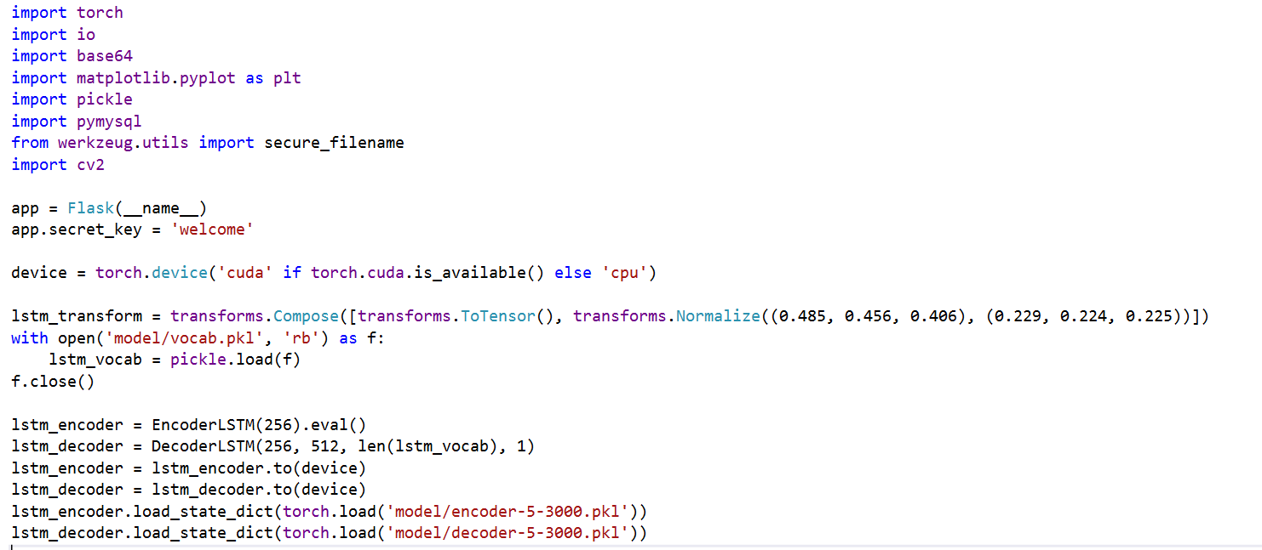

Slide 21
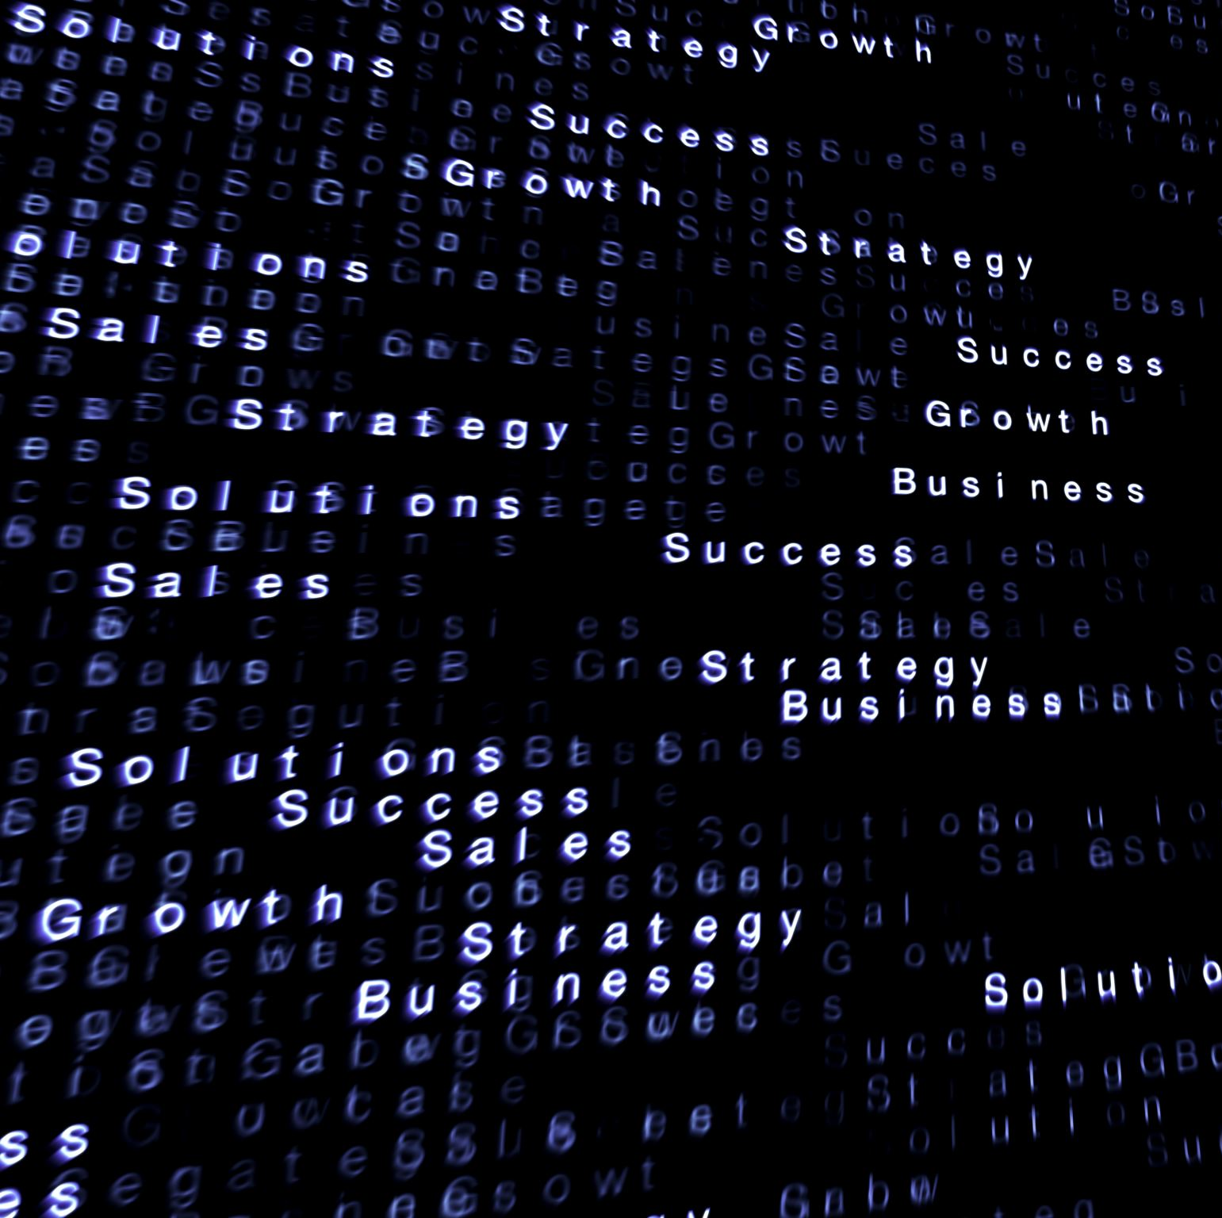
NLTK
NLTK (Natural Language Toolkit) is used in the provided code for tokenizing captions.
Tokenization: In the context of image captioning, captions need to be tokenized into individual words or tokens before they can be processed further. This tokenization process is essential for converting raw text data into a format that can be used by the image captioning model..
Text Preprocessing: NLTK offers various text preprocessing techniques, such as lowercasing, removing punctuation, and stemming or lemmatization. Clean and standardized text data can improve the performance and accuracy of the model.
Vocabulary Building: NLTK can also be used to build the vocabulary or word map needed for mapping words to indices in the image captioning model. By processing the captions using NLTK, unique words can be identified, and a vocabulary can be constructed, which is essential for encoding captions into numerical format for model training and inference.

Slide 22
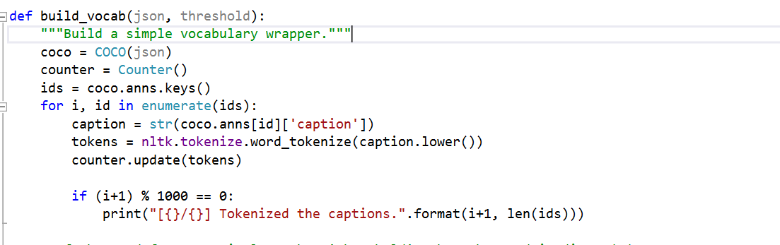

Slide 23
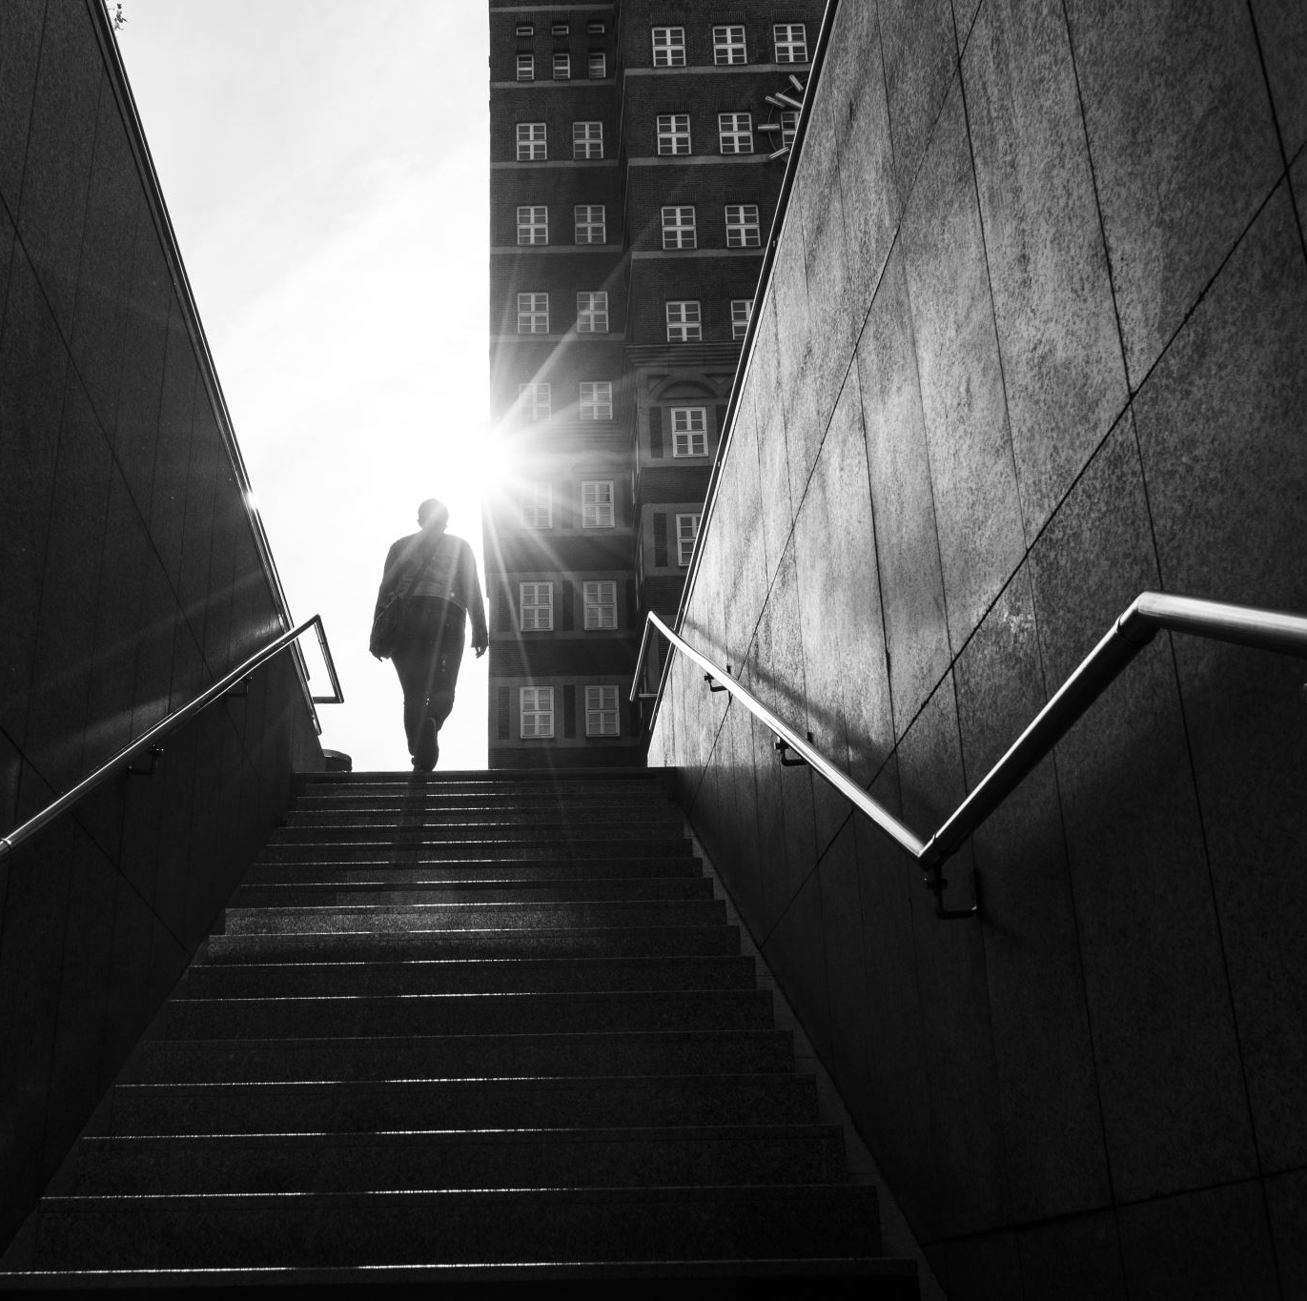
Challenges

Slide 24
Ambiguity in Images: Images often contain elements or scenes that can be interpreted in multiple ways. For example, an image of a person holding a bat could be interpreted as playing baseball, cricket, or even as part of a theatrical performance
Plausible Interpretations: In addition to ambiguity, images may also contain elements that have multiple plausible interpretations based on the viewer's perspective or background knowledge. For instance, an image of a crowded street could be interpreted as a busy market, a protest march, or a festival procession, depending on the context and visual cues.
Compatibility issue: Between these two python and tprch we had issues related to versions of few liabraries.
Contextual Appropriateness: While generating diverse captions, it's crucial to ensure that the captions are contextually appropriate and semantically coherent. Each caption should not only capture a different aspect of the visual content but also maintain coherence and relevance to the overall scene depicted in the image.

Slide 25
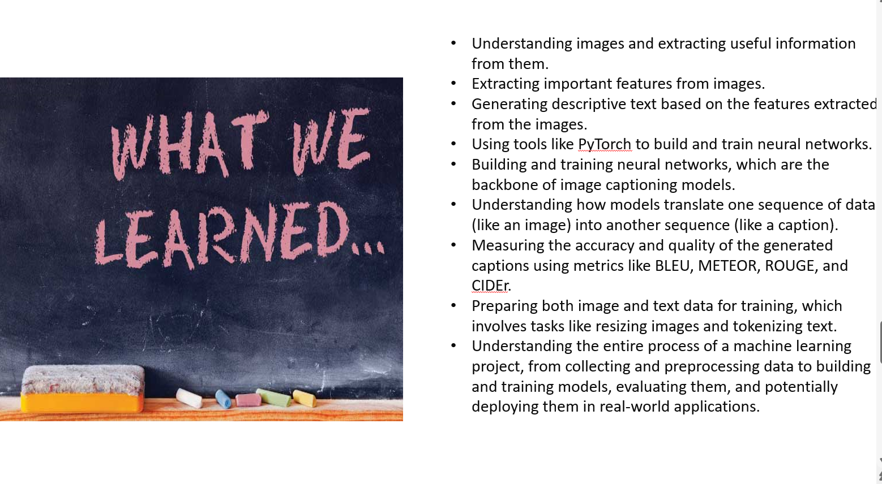

Slide 26
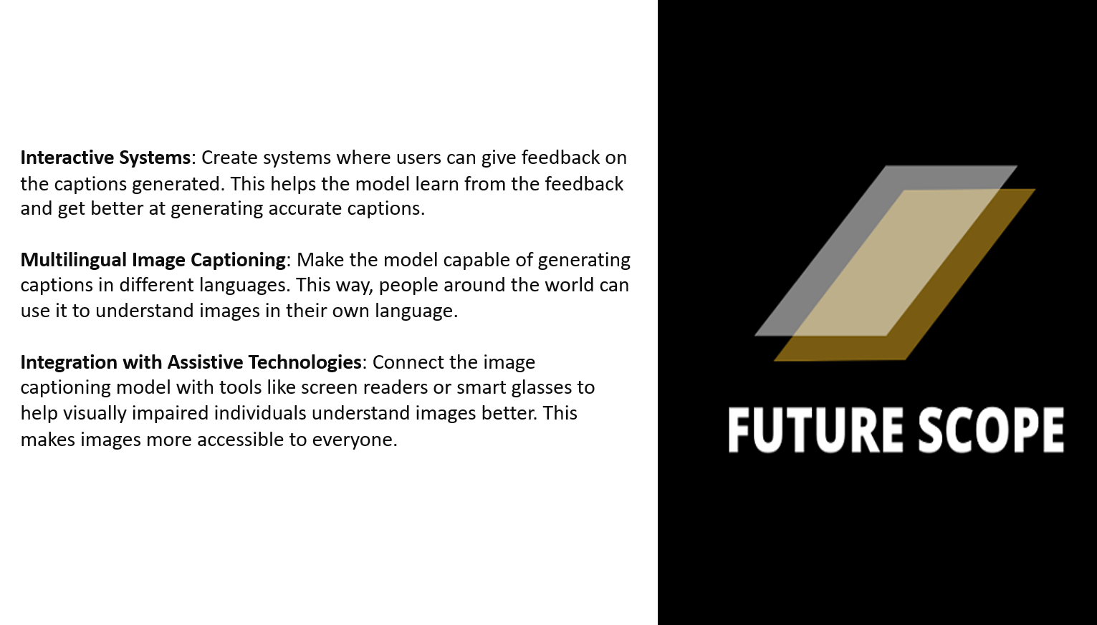

Slide 27

Demo

Slide 28

Thank you

